Slide 1
And the soul shall Dance
Done by:
Omraan Zafar – 13
Ayush Bhattacharya – 04
Dhruv Sanadi - 06

Slide 2
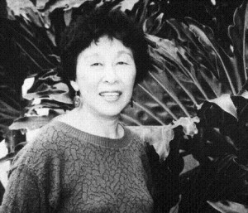
About The Author
Wakako Yamauchi, born Wakako Nakamuro in 1924 to Japanese immigrant parents, is a female Asian American playwright, short story writer, painter, and poet who allows her struggles as a Japanese American shine through her work.
When she was only seventeen her family was sent to Poston concentration camp in Arizona for a year and a half, and then relocated to Utah, and Chicago.
Yamamoto is one of the biggest influences on her work.
Yamauchi also suffered due to the Great Depression. Relations between Japan and the US turned sour, leading to a negative view of Japanese Americans and laws restricting their right to property.

Slide 3
Introduction and Setting
Some of the themes in the story are abuse, sexism and identity.
During that time, Japanese Americans were targeted the most.
The story is about a family in the Imperial Valley near the Mexican border. It is set in the early 1930s.
The great depression left a deep sense of poverty.
The set for the play is very minimalist, including but not limited to: a kitchen table, a wooden bench, 4 chairs, a bed, and a wall calendar.
Audiences were moved by the explosion of held back emotions. For many audiences feeling the wrath of Racism, this play brings back depressing feelings.
Wakako Yamauchi’s live experiences in the American concentration camps influenced her writings later in career as a playwright and short-story writer.

Slide 4
Characters
Masako
An 11 year old American born Japanese girl struggling to understand where she fits into a prejudiced white America. She is the daughter of Murata and Hana and is constantly in need of advice from them, as she is of a more Americanized generation of Japanese Americans. She is an imaginative and sensitive girl who is seen caring about others.
Kiyoko
A 14 year old Japanese born girl who was brought over from Japan by her father, Oka, after the death of her mother, Shizue. Seeking a better life with the help of Masako, she struggles to understand the ways of America. In this story we see very little of her. She is her fathers favorite and is seen to be deeply hurt when her parents fight.

Slide 5
Murata
A 40 year old Japanese born American farmer, father of Masako, and husband to Hana. Murata strives to be the best example of hard work, hope and kindness that he can be and to be the mediator of many situations.
Hana
A Japanese born American Farmer, mother of Masako, wife of Murata. Hana has a realistic outlook on the Murata family's situation in America, and seeks a better life, hoping to return to Japan. She is shown as a very sensitive woman who cares about others. She helps Kiyoko when she is scared after seeing her parents fight by allowing her to sleep at her house. She also sympathizes with Emiko

Slide 6
Oka
A 45 year old Japanese born American Farmer in his second marriage to Emiko and father to Kiyoko. As he is a neighbor to the Murata family, his unpleasant relationship with Emiko is very noticeable. He does not like his new wife as he believes that she has been pushed onto him forcefully by his in laws.
Emiko
A 30 year old Japanese woman, wife of Oka and Sister to Shizue. Emiko was sent by her family in Japan to be Oka's second wife as a punishment for the dishonorable acts she committed in Japan. She does not like her current life and despises her husband. She has a habit of drinking a lot and fights a lot with her husband. She lives in her own bubble and is constantly being tormented by her inner demons.
Shizue
Deceased Japanese former wife of Oka. We are introduced to her only at the latter end of the story and not much of her is known.

Slide 7

THEMES
The lives of the Japanese Americans
Identity
Abuse
Sexism
Alcoholism

Slide 8
ANALYSIS
“It’s alright to talk about it now. Most of the prinicipals are dead, except of course, me and my younger brother and possibly Kiyoko Oka…”
Narrator wants to speak about something that does not matter at present. Moreover, the principal characters being dead gives her the license to speak about it.
“We didn’t hobnob much with them, because you see, they were a childless couple and we were a family…”
“Not only were they childless, impractical in an area with large families were looked upon as labor potentials, but there was a certain strangeness about them”
The above quotes show us that, being a childless couple was something that irked Masako’s family. It displays the deep rooted stigmas that were a part of the Japanese culture.

Slide 9
“Mrs. Oka was small and spare…But more than this, Mrs. Oka was different”
Provides the reader with Masako’s perspective on Mrs. Oka.
“I thought Mrs. Oka might be insane and asked my mother about it…said that Mrs Oka loved her sake”
“My mother’s statement explained much…Mrs. Oka loved sake in the way my father loved his, in the way of Mr Oka, and the way I loved my candy.”
“That her psychology may have demanded this anaesthetic, that she lived with something unendurable did not occur to me…or the masochism that permitted her to display those wounds to us.”
First time reader is provided with the insight about Mrs. Oka’s lifestyle and moreover, her dependence on substances such as liquor and cigarettes. Masako’s perspective on Mrs Oka’s lifestyle is also given.

Slide 10
“Her aberration was a protest of the life assigned to her; it was obstinate but unobserved, alas, unheeded, “Strange” was the only concession granted to her.”
“My disappointment was keen and apparent. Kiyoko-san stepped forward shyly, then retreated with a short bow and small giggle, her fingers pressed to her mouth.”
Masako is disappointed when she first meets Kiyoko-san. Her expectations are not met. It also shows the contrast in cultures.
“I was aware though that drunken savage brawling had brought Kiyoko-san to us.”
Displays the consequences of alcoholism, how it can affect the psyche of the people who suffer from it and the psyche of the people around those who suffer from it.

Slide 11
“As the weather changed, Kiyoko-san became noticeably more cheerful…Mrs Oka was never with them.”
“At first my mother watched their coming…”They’ve left her home again; Mrs Oka is alone again, the poor woman.””
Weather could be considered a metaphor for the change in Mr Oka’s as well as Kiyoko San’s mood.
Mrs Oka is driven further down into isolation and loneliness.
“Drink, always drinking and fighting”
“Endure, soon you will be marrying and going away.”
The fights still continued to occur at Kiyoko’s home. The response that Masako’s mother gives is that her leaving the home and getting married is the solution to moving away from these issues. The lack of choice implied in the response by her shows the patriarchal society that they used to live in.

Slide 12
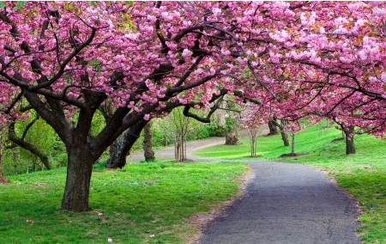
“Red lips pressed against a glass
Drink the purple, purple wine
And the soul shall dance”
“Falling, falling, petals on a wind”
- The song helps us derive the meaning of the title.
- The last line Mrs. Oka sings while walking away could have several meanings.

Slide 13
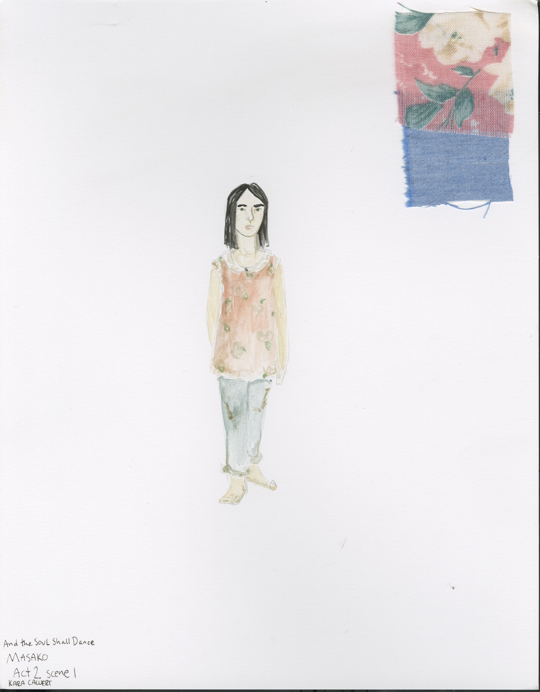
Conclusion
-The story is about clashing philosophies on life.
-Themes discussed are still very relevant in current day society.
-Masako’s perspective adds dimensions to the story.
-Freedom to the choice of life.
-

